Slide 1

GSX8 - Next Generation GIS
mapa.KingProstor.si

Slide 2
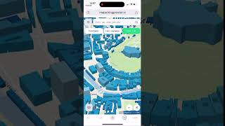
mapa.KingProstor.si

Slide 3
Hvala!

